Slide 1
K-12 Career Development
Individual Career and Academic Plan (ICAP)
Dr. M. Rene’ Yoesel, LPC / Chrissy Bashore / Amber Ernst
January 2019
Notes:
Important points:
The ICAP template can be used stand alone or revised as needed.
The ICAP template is best practice but other templates that meet statutory requirements can be used.
The ICAP template is compliant with SB638.
Coming soon, Missouri Connections platform will contain the ICAP template.
Best practice would be that all students grades 8-12 utilize the same ICAP template.
Some schools may find it beneficial to start with the 8th grade and phase in following 8th grade classes over the next four years.

Slide 2
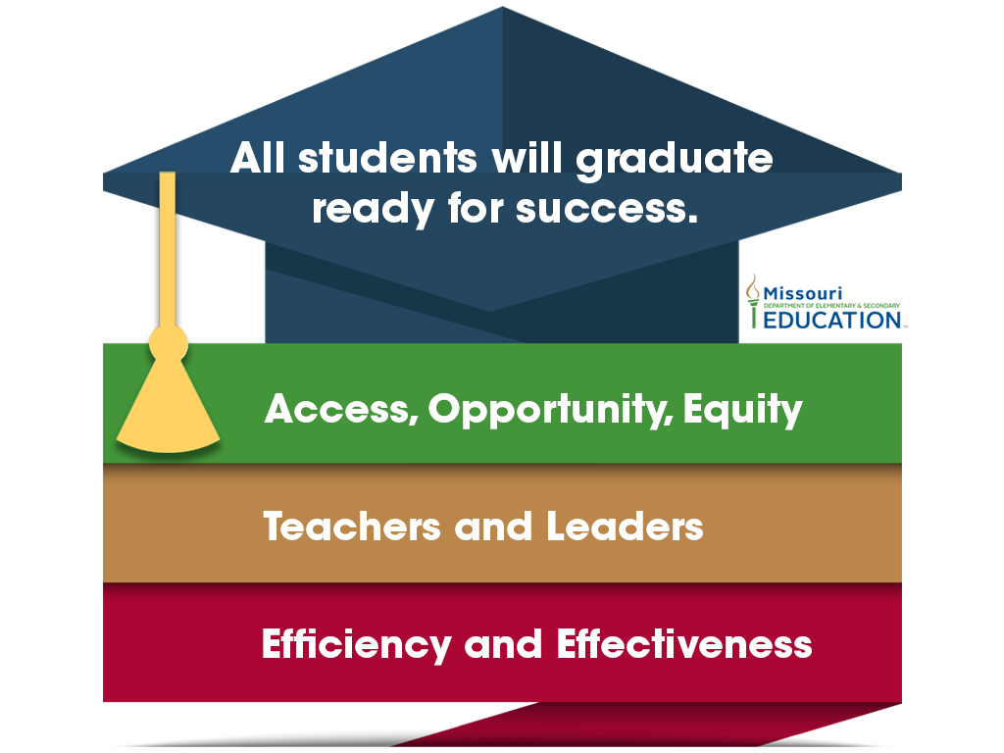
Show-Me Success

Slide 4
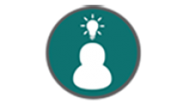
Career Development Curriculum
ICAP
Individual Career
and Academic Plan
K-12 Career Development
STEAM Events
Notes:
These four career development opportunities support the career domain of a comprehensive school counseling program.
Career Development begins in kindergarten and is exemplified by students who are knowledgeable about multiple options.

Slide 5
K-12 Career Awareness/Exploration
Elementary school is a crucial time for developing Career awareness
ASCA recognizes that career education begins in Kindergarten and is exemplified by students who are knowledgeable about career and postsecondary options
School counselors play a critical role in students’ career development and ICAP preparation by introducing careers and the world of work beginning in lower elementary
Notes:
Emphasize the importance of a K-12 program and that elementary school is a crucial time for developing career awareness and preparation for the ICAP.
It is important for elementary school counselors to understand their role in career awareness and ICAP preparation.

Slide 6
From PPOS to ICAP
Compliant with SB638 (2016) 167.903
167.903. 1. Each student prior to his or her ninth grade year at a public school, including a charter school, may develop with help from the school's guidance counselors a personal plan of study, which shall be reviewed regularly, as needed by school personnel and the student's parent or guardian and updated based upon the needs of the student. Each plan shall present a sequence of courses and experiences that conclude with the student reaching his or her postsecondary goals, with implementation of the plan of study transferring to the program of postsecondary education or training upon the student's high school graduation
Notes:
Schools are NOT mandated to have a “four year” plan, but if they do then they MUST present a sequence of courses and experiences that conclude with the student reaching his or her postsecondary goals …
*note* Per new legislation HB2428 school guidance counselor is now referred to as school counselor.
Personal plan of study has been updated to individual career and academic plan (ICAP).

Slide 7
Compliant with SB638 Section 167.903, RSMo
The plan shall include, but not limited to:
(1) Graduation requirements
(2) Career or postsecondary goals
(3) Coursework or program of study related to career and
postsecondary goals, which shall include, if relevant,
opportunities that the district or school may not directly offer
(4) Grade-appropriate and career-related experiences, as outlined in
the grade-level expectations of the Missouri comprehensive
guidance program
(5) Student assessments, interest inventories, or academic results
needed to develop, review, and revise the personal plan of study,
which shall include, if relevant, assessments, inventories, or
academic results that the school district or charter school may offer.
Notes:
These five criteria are mandated for schools implementing a “four year” plan (PPOS/ICAP) and are embedded in the ICAP template.
“Guidance” is used here per the language in SB638, however that language has been changed per statute (2428) to SCHOOL COUNSELING PROGRAM
PPOS is also antiquated language and is now referred to as ICAP
*Language in statute can not be changed so it is important to note these changes in the presentation

Slide 8
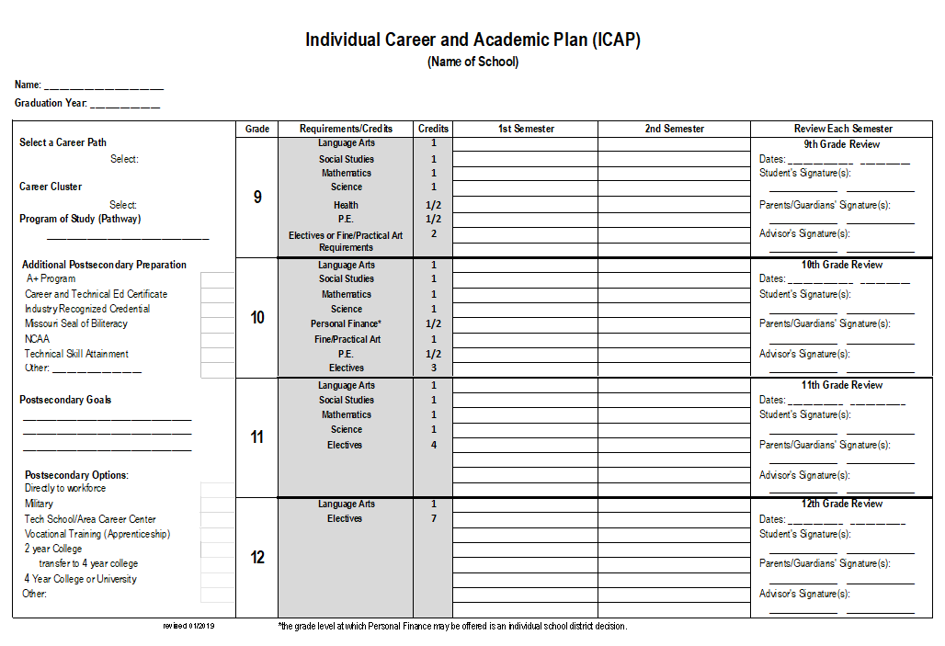
ICAP Page 1
Notes:
Beginning in the left column of the template the following slides outline each section of the ICAP
Best practice is that an ICAP should be reviewed each semester with parent or guardian signatures (but note this is not mandated by law)

Slide 9
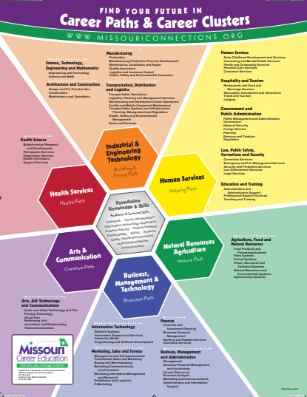
Paths, Clusters and Pathways
Career Planning
Notes:
Students are presented with the 6 career paths in elementary school, the 16 clusters in middle school and the 79 pathways in high school. A Program of Study is one of the 79 Pathways. A recommended resource to address student’s interest would be the Missouri Connections Career Cluster Inventory Assessment.

Slide 10
Additional Postsecondary Preparation

Slide 11
A+ Designated Schools
Be a U.S. citizen or permanent resident.
Enter into a written agreement with your high school prior to graduation.
Attend a designated A+ high school for 3 years prior to graduation.¹
Graduate from an A+ designated high school with an overall grade point average of 2.5 or higher on a 4.0 scale.
Have at least a 95% attendance record overall for grades 9-12.
Perform at least 50 hours of unpaid tutoring or mentoring, of which up to 25% may include job shadowing prior to graduation. ²
Maintain a record of good citizenship and avoid the unlawful use of drugs and/or alcohol while in grades 9-12.
Have achieved a score of proficient or advanced on the Algebra I end of course exam or a higher level DESE approved end-of-course exam in the field of mathematics.³
Contact:
Office of Quality Schools (School Designation)
573-522-3651
Dept. of Higher Ed
(Scholarship/Award Information)
573-751-2361
(full details) https://dhe.mo.gov/ppc/grants/aplusscholarship.php

Slide 12
Career And Technical Education Certificate
For more information visit: https://dese.mo.gov/sites/default/files/cte-certificate-criteria.pdf
FAQ: https://dese.mo.gov/sites/default/files/cte-certificate-frequently-asked-questions.pdf
Notes:
This third page of the ICAP is applicable to Career and Technical Education Certificate Requirements.
Typically a student would begin CTE coursework during their junior year; however 95% attendance is one requirement and that starts in the freshman year.
Any student who enters high school in the 2017-2018 school year and thereafter and meets all of the criteria set forth by the State Board of Education shall be eligible to earn a CTE certificate.

Slide 13
IRC & TSA
Janice Rehak
Coordinator OCCR
Janice.Rehak@dese.mo.gov
https://dese.mo.gov/college-career-readiness/career-education/technical-skills-attainment-industry-recognized-credential
Industry Recognized Credential (IRC): A portable, recognized credential that validates an individual has successfully demonstrated skill competencies in a core set of content and performance standards in a specific set of work-related tasks, single occupational area, or a cluster of related occupational areas. A student does not have to be a concentrator to take an IRC.
Technical Skill Attainment (TSA): A technical skill assessment measures skill proficiency of Career and Technical Education (CTE) students who are concentrators (a student who has earned three or more sequential credits in any state-approved CTE program grades 9-12) and has completed an approved CTE program. A TSA is not intended to be taken after every course.
Concentrator: A student who has earned three or more sequential credits in any state-approved CTE program grades 9-12. Sequential credits can consist of courses that crossover into different program areas. (Note: It is a local decision to determine the sequence; therefore, it is a local decision to determine when a student becomes a concentrator and completes a program).
Notes:
The IRC/TSA list has been aligned to the American Council on Education (ACE) postsecondary credit review.
Guidance for selecting IRC’s and TSA’s, summaries and help documents can be found on the DESE website.
Information regarding IRC and TSA compliance with Section 167.902, RSMo can be found on the legislation tab of the DESE school counseling webpage.

Slide 14
Seal of Biliteracy
The Missouri Seal of Biliteracy (SoBL) and Distinguished Missouri Seal of Biliteracy is awarded to graduating high school students in districts with a DESE-approved program, who have demonstrated achievement in English, a Language Other Than English (LOTE) and sociocultural competence. All Missouri students studying any of the world’s languages are potential Seal candidates.
Full information can be found: https://dese.mo.gov/college-career-readiness/curriculum/english-language-development/missouri-seal-biliteracy
Institutions offering endorsements currently include:
Evangel University
Missouri State University
Missouri Southern University
Northwest Missouri State University
Truman State University
University of Central Missouri
Ryan Rumpf
Director of ELD & World Languages
Ryan.Rumpf@dese.mo.gov
Notes:
The vision is to help students recognize the value of their academic success and see the tangible benefits of being bilingual.
A short introductory webinar and implementation guide is located on the DESE website.
Institutions offering endorsements may include credit hours at no tuition charge.

Slide 15
NCAA
Generally NCAA guidelines dictate:
Graduation requirement with specific GPA and core courses
Minimum SAT or ACT scores
Visit the website to learn about the qualifications for each division
https://www.athleticscholarships.net/academic-requirements.htm
Notes:
National Collegiate Athletic Association

Slide 16
Other: _____________
Examples may include:
NAIA
Honor Diploma
Registered Apprenticeship
Notes:
National Association of Intercollegiate Athletes
This line is for any additional postsecondary preparation that is not listed on the template.

Slide 17
Postsecondary
Goals
List your career choice (what do I want to do?)
Notes:
The program of study is one of the 79 career pathways and your postsecondary goal is drilling down to a career choice and direction. This would be beneficial especially for a student whose interest is a deeper dive into a specific pathway program of study. IE: Path: Nature Cluster: Agriculture, Food and Natural Resources Pathway: (Program of Study) Plant Systems Postsecondary goal would be a deeper dive into the Plant Systems Pathway. Coursework would be different for a student interested in becoming an Arborist, Irrigation Engineer, or Soil Scientist all of which may fall under the same pathway so understanding the postsecondary goal is important in schedule planning.

Slide 18
Postsecondary
Options
Directly to workforce
Military
Tech school/area career center
Vocational training (apprenticeship)
2 year college
2 year transfer to 4 year college
4 year college or university
Other:
Notes:
Postsecondary options is the “how” a student will achieve their postsecondary goal.

Slide 19
9-12 Requirements/Credits
Fill in district & state graduation requirements
https://dese.mo.gov/search-mo-gov/graduation%2Bhandbook
Align coursework to postsecondary goals using postsecondary options
Virtual instruction opportunities should be considered for class choices.
Missouri Course Access Program: https://mocap.mo.gov/
Graduation Handbook:
Norma Anderson
Supervisor, School Improvement
Norma.Anderson@dese.mo.gov
MOCAP:
John Robertson
Coordinator of Educational Support Services
John.Robertson@dese.mo.gov
Notes:
MOCAP credits gained shall be accepted by the receiving LEA.
MOCAP is a good resource for higher level coursework not offered by the school district.

Slide 20
9-12 Requirements/Credits
Denote advanced coursework with abbreviations such as DC (dual credit), AP, or IB in addition to MOCAP.
Computer Science (House Bill 3) can substitute for math or science credit
MAY NOT be accepted at all colleges/universities which districts SHALL communicate to students (https://legiscan.com/MO/text/HB3/2018/X2)
A student may fulfill one unit of academic credit with a district/charter approved agriculture or career and technical education course for any English language arts, mathematics, science, or social studies unit required for high school graduation in any combination up to fulfilling one requirement in each of the four subject areas. House Bill 1189 (2014)
https://dese.mo.gov/sites/default/files/Graduation_Handbook.pdf (page 27)
Notes:
Future legislation impacting coursework will be detailed on the link below and in the Graduation Handbook:
https://dese.mo.gov/college-career-readiness/school-counseling/legislation
HB3 “A school district shall communicate to students electing to use a computer
science course for a mathematics unit that some institutions of higher education may
require four units of academic credit in mathematics for college admission. The parent,
guardian, or legal custodian of each student who chooses to take a computer science course
to fulfill a unit of academic credit in mathematics shall sign and submit to the school
district a document containing a statement acknowledging that taking a computer science
course to fulfill a unit of academic credit in mathematics may have an adverse effect on
college admission decisions.”

Slide 21
Core 42
The completion of the CORE 42 at any public institution of higher education will transfer to every other public institution of higher education in the state and substitute for the receiving institution’s general education requirement. Individual courses that comprise the CORE 42 are guaranteed to transfer one-to-one among all public colleges, universities and participating independent institutions.
Angelette Prichett
Director of Academic Program and Initiatives
Angelette.Prichett@dhe.mo.gov
https://web.dhe.mo.gov/dhe/coursetransfertracker/homepage.faces
Notes:
This initiative would be important for dual credit students and students whose postsecondary options includes college transfer.

Slide 22
ICAP Review
Pursuant to Section 167.903, RSMo “which shall be reviewed regularly, as needed by school personnel and the student's parent or guardian and updated based upon the needs of the student.”
Best practice suggests semester review to include student, parent, and advisor signature
Notes:
Section 167.903 pertains to SB 638, 2016

Slide 23
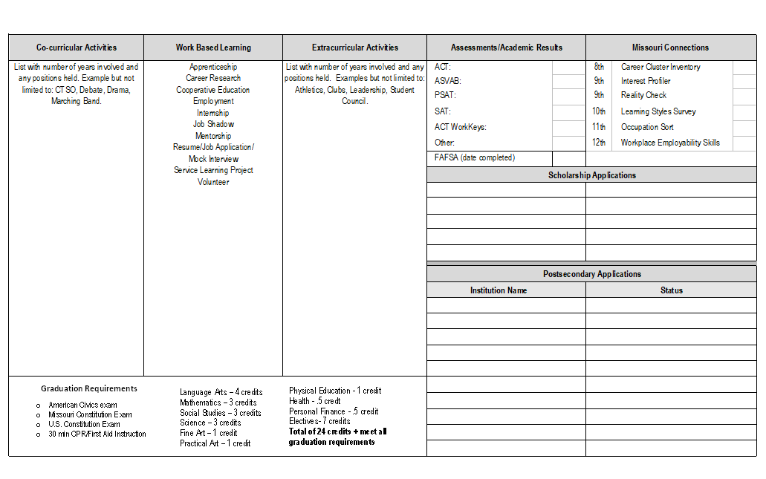
ICAP Page 2

Slide 24
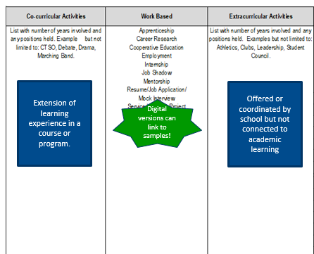
List number of years and positions held in applicable categories
Work Based Example
Job shadowed at local nursing home
Brief description of experience
Awards & Recognition
Can be added under each category of extra and co-curricular.
For example
FBLA
President (2015-2016)
District Officer (2016-2017)

Slide 25
Registered Apprenticeships
Example of Work Based Learning
Youth Apprenticeship (16-18) combines
classroom education,
on-the-job training,
experienced business mentor,
a salary, and
scheduled wage progression.
Missouri's industries need highly skilled workers. YA programs work to build a stable workforce pipeline for employers, as well as provide our youth with more local paths to career skills training.
Dr. Oscar Carter
Director of Skilled Technical Sciences
Oscar.carter@dese.mo.gov
https://dese.mo.gov/college-career-readiness/career-education/registered-youth-apprenticeships-parents-and-students

Slide 26
Minimum State Graduation Requirements
Effective for graduation class of 2021.
Required for all students beginning in year 2017-2018
Graduation Handbook: https://dese.mo.gov/search-mo-gov/graduation%2Bhandbook

Slide 27
Assessments/Academic Results
ACT and SAT are college entrance exams
PSAT is the “preliminary” SAT
ASVAB (Armed Services Vocational Aptitude Battery) is administered by military personnel
ACT WorkKeys is a career readiness assessment
Include assessment date (specific scores are not required)

Slide 28
FAFSA
Many resources at: https://dhe.mo.gov/fafsa-completion/
MyStudentAid App: https://itunes.apple.com/us/app/mystudentaid/id1414539145?mt=8
Notes:
Date completed is recommended to be listed on the ICAP, but not required.

Slide 29
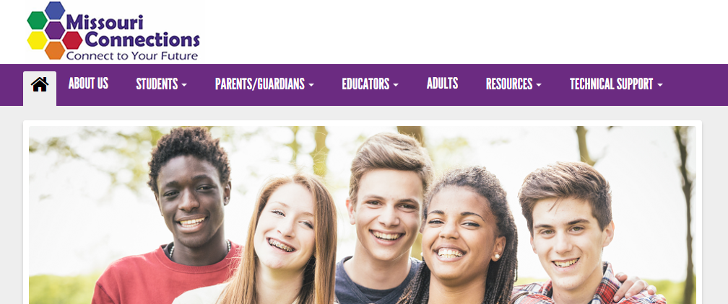
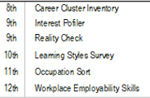
Missouri Connections
Assessments that meet School Counseling GLEs
Guest logins can be used for any of these assessments
https://portal.missouriconnections.org/
Notes:
Missouri Connections is a state funded online career education program that is recommended for best practice to align with the individual career and academic plan.
Check box when completed.

Slide 30
Postsecondary & Scholarship Applications
List application names
Status Categories may include:
Submitted
In progress
Interested

Slide 31
Chrissy Bashore
Assistant Director School Counseling
Missouri Connections State Operator
Chrissy.Bashore@dese.mo.gov
Charlene Piel is the state trainer: moconnections@nwmissouri.edu

Slide 32
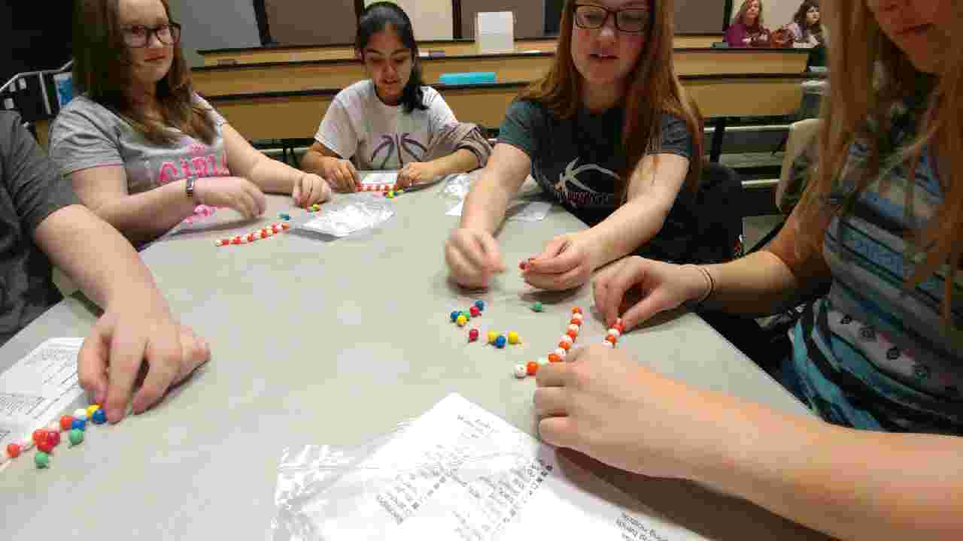
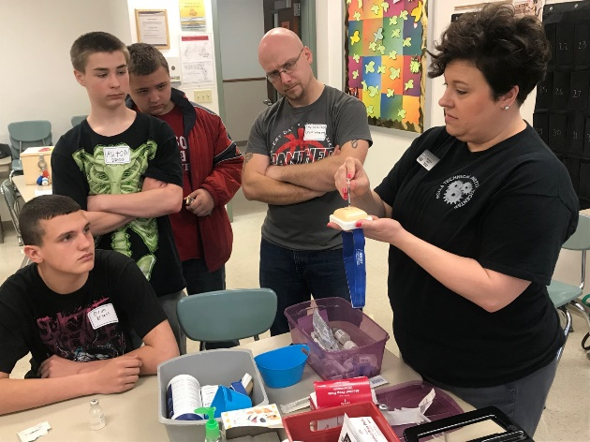
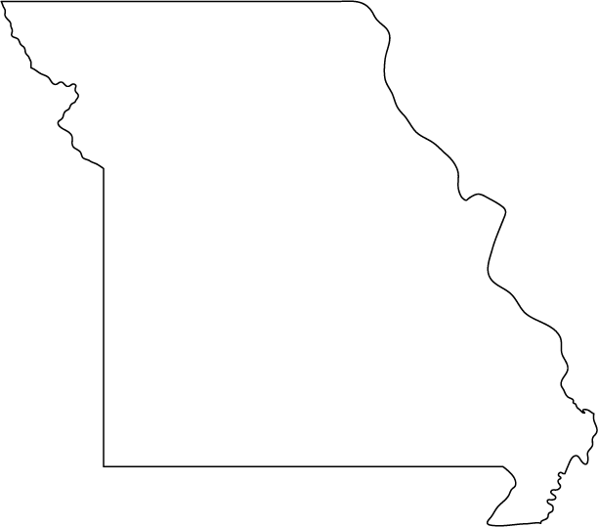
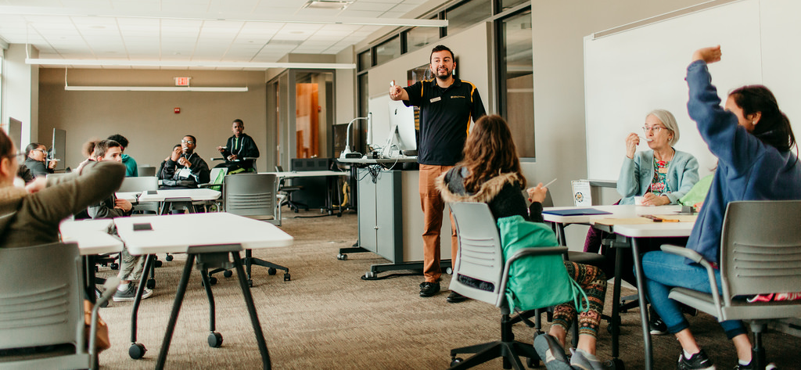
STEAM Events
7/8 grade
Regionally located
Hands-on events
Nontraditional career focus
Contact your regional Career Advisor for more information.
Notes:
STEAM events for 7th and 8th grade girls and boys, focused on non-traditional careers are offered in each of the nine RPDC regions.

Slide 33
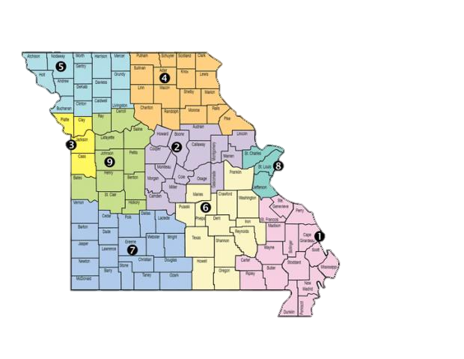
 | Career Advisor
1 | Marisa Bowen mlbowen@semo.edu
2 | Jeff Beiswinger Beiswingerj@Missouri.edu
3 | Gwen Poss possg@umkc.edu
4 | Polly Matteson pmatteson@Truman.edu
5 | Allyson Graham agraham@nwmissouri.edu
6 | Jackie Marling marling@mst.edu
7 | Marci Dowdy mdowdy@missouristate.edu
8 | Michelene Carbol mcarbol@edplus.org
9 | Jay Webster webster@ucmo.edu
Your Regional Career Advisor will be able to help with implementation of the ICAP and Missouri Connections.

Slide 34
DESE School Counseling Staff Contact Information
Dr. M. Rene’ Yoesel, LPC – Rene.Yoesel@dese.mo.gov
Chrissy Bashore – Chrissy.Bashore@dese.mo.gov
Amber Ernst- Amber.Ernst@dese.mo.gov

